Slide 1



Myntra Sales Data Analysis Source: : https://www.kaggle.com/datasets/skmewati/myntra-sales-dataset Dataset: myntra_dataset Email: srinijavarikuppala@gmail.com Phone : 8247403927 LinkedIn :https://www.linkedin.com/in/varikuppala-srinija-8117032a5/
Myntra Sales Dataset Analysis Using Pyspark
Varikuppala Srinija

Slide 2
Introduction
This presentation provides an analysis of Myntra sales dataset
- Structure and Uniqueness
- Brand Distribution
- Category and sub-Category Representation
- Price Insights
- Rating and reviews patterns
- Availability and popularity
- Key relationships

Slide 3
Initial Analysis of the Dataset
The Myntra dataset provides a comprehensive view of products across brands, categories, prices, and ratings, just like the Office dataset gave insights into employees. It highlights Myntra’s diverse fashion catalog, customer engagement through ratings, and brand dominance patterns—making it useful for retail analytics, recommendation engines, and trend studies.
1. Structure and Uniqueness :The dataset consists of rows of products with attributes such as product ID, brand, category, sub-category, product name, price, rating, reviews, and availability.Each product has a unique identifier (similar to employee_id in the office dataset).Brand names and product names have duplicates because multiple items may fall under the same brand or style.
2. Brand Distribution: Several brands are represented, with top fashion brands (like Roadster, HRX, W, H&M, etc.) having the highest product counts.Some niche brands have fewer items, showing Myntra’s mix of mainstream and specialty fashion

Slide 4
3. Category and Sub-Category Representation: The dataset covers multiple categories: clothing, footwear, accessories, and more.Sub categories include specific product types like T-shirts, kurtas, dresses, sneakers, jeans, and formal wear.Clothing dominates the dataset (similar to HR being the largest department in the office dataset).
4. Price Insights: Prices range from very low-cost items (affordable wear) to premium/high-end products.The average price sits in the mid-range, showing Myntra’s balance of budget and premium fashion.A wide standard deviation in prices indicates strong diversity in affordability.Outliers (very high prices) likely belong to premium international brands.
5. Rating and Review Patterns: Ratings generally range from 1 to 5, with most items clustered between 3.5 and 4.5, indicating good customer satisfaction.Products with higher reviews are usually from trusted/popular brands.Some products may have no ratings yet, suggesting they are newly listed

Slide 5
6. Availability & Popularity :Availability indicates whether the product is in stock or out of stock.Popular categories (like T-shirts, casual wear, ethnic wear) show higher availability.Seasonal products (like winter jackets or festive ethnic wear) may show fluctuating availability.
7. Key Relationships: Price vs Rating: Premium products don’t always have the highest ratings; mid-priced products often show better satisfaction.Brand vs Popularity: Well-known brands (HRX, H&M, Roadster) get consistently high reviews.Category vs Price: Accessories and casual wear are generally lower priced, while dresses, footwear, and formal wear have higher ranges

Slide 6
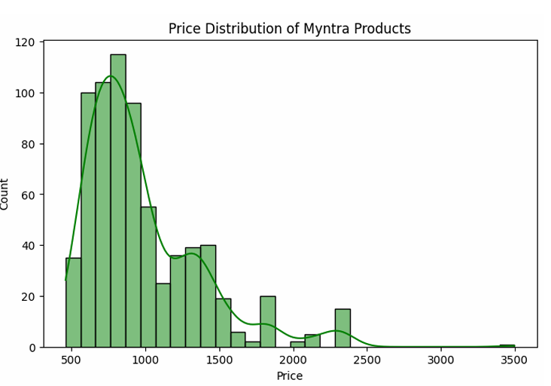
Price Distribution of myntra sales dataset
The histogram shows how product prices are spread across the Myntra catalog. Most jeans are priced in the affordable-to-mid range between ₹700 and ₹1,400. Only a few products lie in the higher price segments, indicating Myntra’s focus on budget-friendly fashion.

Slide 7
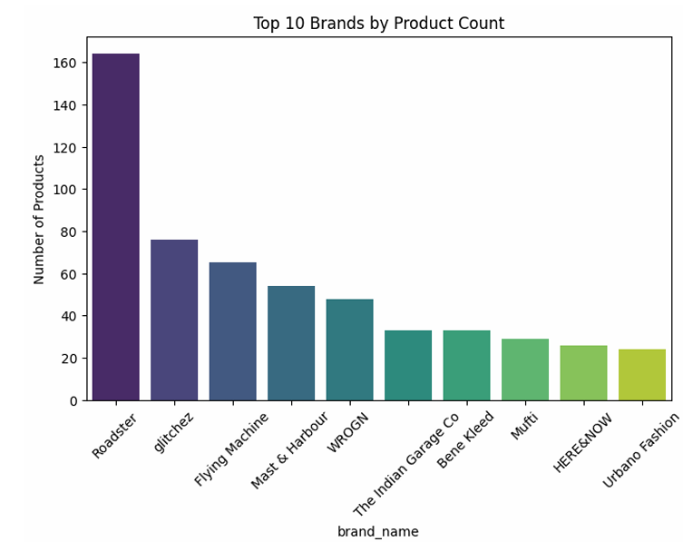
Brands By Product Count
This bar chart highlights the dominance of certain brands like Roadster, WROGN, and Flying Machine. These brands contribute the maximum number of listings, showing Myntra’s reliance on youth-focused fashion. Smaller brands exist but contribute less to the overall catalog diversity.

Slide 8
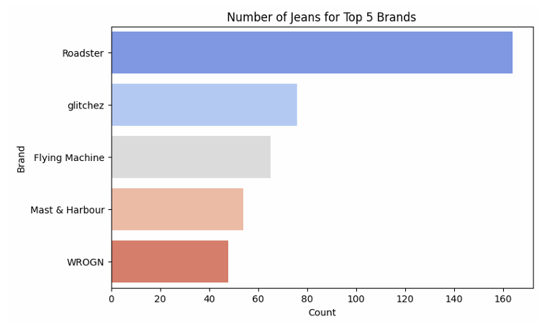
Get top 5 brands Countplot
This visualization breaks down the number of jeans for the five most popular brands. Roadster leads significantly, followed by WROGN and Flying Machine. Such distribution shows Myntra’s heavy catalog focus on a few key brands to attract maximum customer attention.

Slide 9
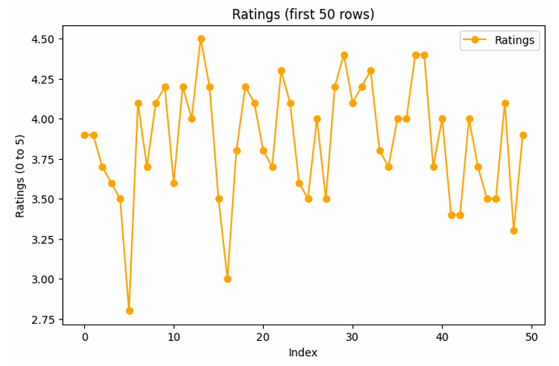
Ratings of Myntra sales
The line plot tracks ratings across the first 50 products. It shows fluctuations in customer ratings, with most products clustered between 3.5 and 4.5 stars. This reinforces the observation that customer satisfaction is generally stable, with only minor variations.

Slide 10
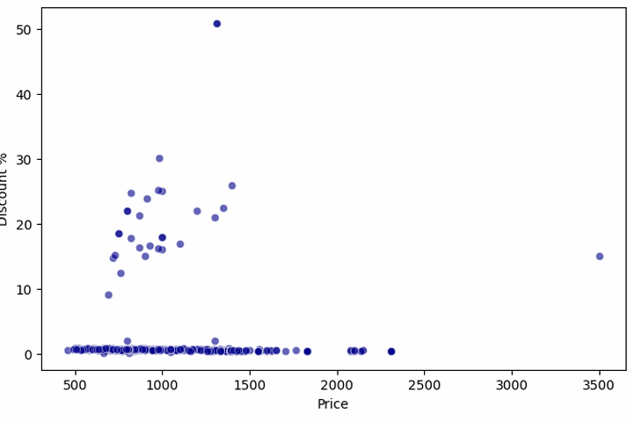
Discount vs Price
The scatterplot shows how discounts vary with product price. Mid-range jeans often have the highest discount percentages, while premium jeans show comparatively lower discounts. This reflects Myntra’s strategy of pushing mid-priced items with stronger offers to boost sales.

Slide 11
Dataset Observation
When analyzing the price distribution, it is evident that most jeans are positioned in the mid-range category, typically between ₹749 and ₹1,393. The average price stands at around ₹1,092, while the median price is slightly lower at ₹949, showing that Myntra emphasizes affordability while still maintaining premium options.
MRP values are much higher (average around ₹2,609), indicating that the platform employs aggressive discounting strategies to attract customers. In fact, the discount percentages range from 5% up to 50.88%, with an average discount of approximately 61%. This highlights Myntra’s focus on providing high visible discounts, which is a common e-commerce practice to encourage impulse purchases and boost sales.

Slide 12
Dataset Observation
brand-level representation, Roadster emerges as the most dominant brand with 178 product listings, followed by WROGN (104), Flying Machine (80), glitchez (76), and Mufti (72). This suggests that Myntra’s catalog is heavily skewed towards certain youth-focused brands, which may be strategic to align with customer demand in the fashion segment.
customer sentiment, the dataset reveals an overall positive response, with the average rating across products being 3.9 out of 5. Most products fall in the range of 3.7 to 4.2, suggesting general satisfaction among buyers. A few premium and well-marketed products achieve ratings above 4.5, reflecting higher perceived quality.
relationships between features suggest that discounts are not the only factor driving higher sales or reviews. While products with large discounts tend to attract buyers, brand reputation and perceived quality (reflected in ratings) also play a significant role. For instance, Levis and WROGN products, despite being priced higher, enjoy strong ratings and steady demand, demonstrating that customers value quality and brand trust alongside affordability.

Slide 13
Conclusion
In conclusion, Myntra’s sales model appears to be heavily bestseller-focused, relying on discounts and strong brand presence to drive sales. For sustained growth, Myntra could work towards balancing its catalog by promoting underrepresented brands, optimizing discounts strategically rather than uniformly, and leveraging customer ratings data to enhance recommendation systems. This would ensure not only the success of top-performing products but also broader engagement across the entire product range.

